Slide 1
8.1 Seakeeping
Ship is so far assumed to be in calm water to determine,
- stability of ship
- EHP calculation through Froude expansion
Ship usually, however, encounters waves in the sea.
Ship will respond due to wave action.
output
Input
Response
Excitation
Motions
Structural load
Wave
Wind

Slide 2
8.2 Waves
Wave Creation and Energy
Energy transfer to sea
Wave Creation
High speed ship
Large wave
Wave energy, E= f(wave height²)
Doubling in wave height → quadrupling of Wave Energy
C_{w} at hull speed rapidly increases due to higher wave
creation.

Slide 3
Waves
Wave Energy Sources
Wind : most common wave system energy source
Geological events : seismic action
Currents : interaction of ocean currents can create
very large wave system.

Slide 4
Waves
Wind Generated Wave Systems
The size of these wave system is dependent on
the following factors.
Wind Strength :
- The faster the wind speed, the larger energy is
transfer to the sea.
- Large waves are generated by strong winds.
Wind Duration :
- The longer wind blow, the greater the time the sea
has to become fully developed at that wind speed.

Slide 5
Waves
Wind Generated Wave Systems
Water Depth :
- Wave heights are affected by water depth.
- Waves traveling to beach will turn into breaking
wave by a depth effect.
Fetch
- Fetch is the area of water that is being influenced
by the wind.
- The larger the fetch, the more efficient the energy
transfer between wind and sea.

Slide 6
Waves
Wave Creation Sequence
Ripples and Growing
(W. energy>Dissipation Energy)
Wind Energy
Ripple
(high freq.)
Fully Developed Wave
(W. energy=Dissipation Energy)
Energy Dissipation
due to viscous friction
Reducing
(W. energy<Dissipation Energy)
Swell (low frequency long wave)

Slide 7
Waves
Wind Energy
Ripples
Growing Seas
Fully Developed Seas
Reducing
Swells

Slide 8
Waves
Definitions
Ripple : high frequency, short wave
Fully developed wave : stable wave with maximized wave
height and energy (does not change as the wind continues
to blow)
Swell : low frequency, long wave, high frequency waves
dissipated

Slide 9
Waves
t (sec)
1
T
Sinusoidal Wave- A wave pattern in the typical sine pattern
Period, T- Distance to complete one complete wave (sine) cycle, defined as 2π radians (Here the period is 2/3 second, .667sec)
- Remember that π = 180º, so 2π is 360º, or one complete cycle

Slide 10
Waves
t (sec)
1
π
2π
3π
Frequency, ω - The number of radians completed in 1 second (here the wave completes 9.43 radians in 1 second, or 3π… = to 1.5 times around the circle)
ω = 2π
T
ω is given in RADIANS/sec

Slide 11
Waves
These two formulas for frequency are also referred to as the Natural Frequency, or the frequency that a system will assume if not disturbed:
ω_{n} = 2π
T
ω_{n} = k
m
Where k = spring constant (force/ length compressed/ stretched)

Slide 12
Waves
+ Z_{o}
Z
t (sec)
1
- Z_{o}
T
Displacement, Z - The distance traveled at a given time, t
- Z_{o} reflects the starting position
- Z will be cyclical…it will not be ever-increasing
Z = Z_{o} Cos(ω_{n}t)
…This will give you the height of the wave or the length of the elongation / compression in a spring at a given time

Slide 13
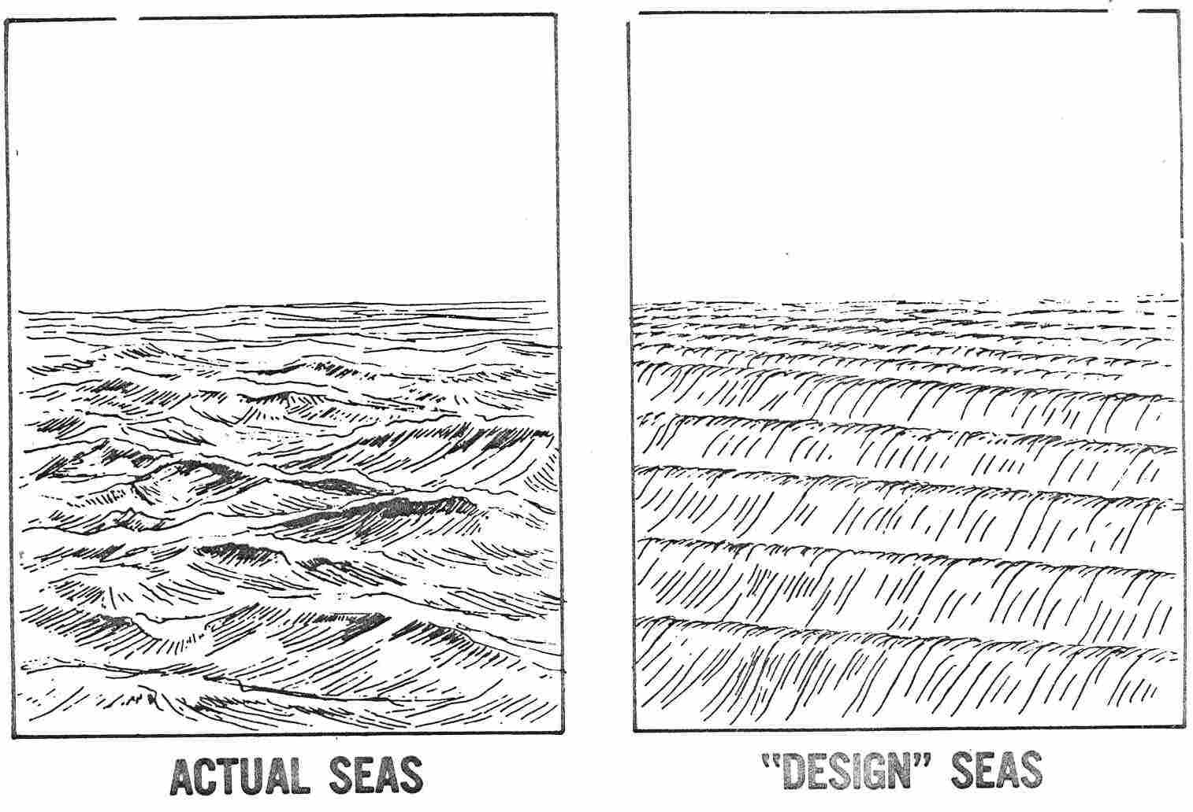
Waves
Wave Superposition

Slide 14
Waves
Superposition Theorem
The configuration of sea is
complicated due to interaction of
different wave systems.
(Irregular wave)
The complicated wave system
is made up of many sinusoidal
wave components superimposed
upon each other.
Fourier Spectral Analysis

Slide 15
Waves
Wave Spectrum
Energy Density
Frequency
Significant wave height :
- Average of the 1/3 highest waves
- It is typically estimated by observers of wave systems
for average wave height.

Slide 16
Waves
Wave Data
Number | Significant Wave Height (ft) |  | Sustained Wind Speed (Kts) |  | Percentage Probability of | Modal Wave Period (s)
 |  |  |  |  |  | Range | Most Probable
 | Range | Mean | Range | Mean
0-1 | 0-0.3 | 0.2 | 0-6 | 3 | 0 | - | -
2 | 0.3-1.5 | 1.0 | 7-10 | 8.5 | 7.2 | 3.3-12.8 | 7.5
3 | 1.5-4 | 2.9 | 11-16 | 13.5 | 22.4 | 5.0-14.8 | 7.5
4 | 4-8 | 6.2 | 17-21 | 19 | 28.7 | 6.1-15.2 | 8.8
5 | 8-13 | 10.7 | 22-27 | 24.5 | 15.5 | 8.3-15.5 | 9.7
6 | 13-20 | 16.4 | 28-47 | 37.5 | 18.7 | 9.8-16.2 | 12.4
7 | 20-30 | 24.6 | 48-55 | 51.5 | 6.1 | 11.8-18.5 | 15.0
8 | 30-45 | 37.7 | 56-63 | 59.5 | 1.2 | 14.2-18.6 | 16.4
>8 | >45 | >45 | >63 | >63 | <0.05 | 15.7-23.7 | 20.0
Modal Wave Frequency :

Slide 17
8.3 Simple Harmonic Motion
Condition of Simple Harmonic Motion
+a
-a
a
A naturally occurring motion in which a force causing displacement is countered by an equal force in the opposite direction.
- It must exhibit a LINEAR RESTORING Force
Linear relation :
The magnitude of force or moment must be linearly proportional
to the magnitude of displacement
Restoring :
The restoring force or moment must oppose the direction of
displacement.

Slide 18
Simple Harmonic Motion
Tension
Compression
- If spring is compressed or placed in tension, force that will try to
return the mass to its original location ⇒Restoring Force
The magnitude of the (restoring) force is proportional to the
magnitude of displacement ⇒ Linear Force

Slide 19
Simple Harmonic Motion
Mathematical Expression of Harmonic Motion

Slide 20
Simple Harmonic Motion
Mathematical Expression of Harmonic Motion
- Equation
- Curve Plot
T
t
- Natural frequency

Slide 21
Simple Harmonic Motion
Spring-Mass-Damper System
spring
mass
damper
C : damping
coefficient
- Equation of motion (Free Oscillation) & Solution
The motion of the system is affected by the magnitude of damping.
⇒ Under damped, Critically damped, Over damped
If left undisturbed, these systems will continue to oscillate, slowly dissipating energy in sound, heat, and friction
- This is called free oscillation or an UNDAMPED system

Slide 22
Simple Harmonic Motion
Spring-Mass-Damper System
Over damped
No-Damping
Under damped
Critically damped
- Under Damped : small damping, several oscillations
- Critically Damped : important level of damping, overshoot once
- Over damped : large damping, no oscillation

Slide 23
Simple Harmonic Motion
Spring-Mass-Damper System
Ship motion (Pitch, Roll or Heave)
Roll
Radiated wave
Friction
Eddy
Motion source : exiting force or waves
Damping source : radiated wave, eddy and viscous force

Slide 24
Simple Harmonic Motion
Forcing Function and Resonance
Unless energy is continually added, the system will eventually come to rest
An EXTERNAL FORCING FUNCTION acting on the system
- Depending on the force’s application, it can hinder oscillation
- It can also AMPLIFY oscillation
When the forcing function is applied at the same frequency as the oscillating system, a condition of RESONANCE exists

Slide 25
Simple Harmonic Motion
External Force, Motion, Resonance
spring
mass
External force
- Equation of motion (Forced Oscillation) & Solution

Slide 26
Simple Harmonic Motion
Forcing Function & Resonance
Condition 1- The frequency of the forcing function is much smaller than the system
Displacement, Z = F/k
Condition 2- The frequency of the forcing function is much greater than the system
Z = 0
THIS IS RESONANCE!
Condition 3- The frequency of the forcing function equals the system
Z = infinity

Slide 27
Simple Harmonic Motion
External Force, Motion, Resonance with damper
b : damping
coefficient
Equation of forced motion
Amplitude of force motion

Slide 28
Simple Harmonic Motion
External Force, Motion, Resonance with damper
Very low damped :Resonance
Motion Amplitude
Heavily damped
Lightly damped
Frequency

Slide 29
8.4 Ship Response
Ship Response Modeling
Spring-mass-damping
modeling
Heave of ship
damping
Additional Buoyancy Force

Slide 30
Ship Response
Encounter Frequency
Motion created by exciting force in the spring-mass-damper
system is dependant on the magnitude of exciting force (F) and
frequency (w).
Motion of ship to its excitation in waves is the same as one of
the spring-mass-damper system.
Frequency of exciting force is dependent on wave frequency,
ship speed, and ship’s heading.

Slide 31
Ship Response
Encounter Frequency
Wave
direction
Crest
V
V
V

Slide 32
Ship Response
Encounter Frequency Conditions
- Head sea : A ship heading directly into the waves will meet the
successive waves much more quickly and the waves will appear
to be a much shorter period.
- Following sea : A ship moving in a following sea, the waves will
appear to have a longer period.
Beam sea : If wave approaches a moving ship from the broadside
there will be no difference between wave period and apparent
period experienced by the ship

Slide 33
Ship Response
Rigid Body Motion of a Ship
6 degrees of freedom
pitch
heave
surge
roll
sway
yaw
Translational motion : surge, sway, heave
Rotational motion : roll, pitch, yaw
Simple harmonic motion : Heave, Pitch and Roll

Slide 34
Ship Response
Heave Motion
Generation of restoring force in heave
= F
F
>
> F
B
B
B
Zero Resultant Force
Resultant
Force
•
G
•
G
DWL
z
z
•
G
•
B
DWL
•
B
•
B
Resultant
Force
C
C
C
L
L
L

Slide 35
Ship Response
Heave Motion
Restoring force in heave
The restoring force in heave is proportional to the additional
immersed distance.
The magnitude of the restoring force can be obtained using
TPI of the ship.
Restoring force

Slide 36
Ship Response
Heave Motion
Heave Natural frequency
: Natural frequency of spring-mass system

Slide 37
Ship Response
Roll Motion
Generation of restoring moment in roll
Creation of Internal Righting Moment
S
S
•
G
G
•
Z
¸
•
B
B
•
F
B
¸
F
B

Slide 38
Ship Response
Roll Motion
Equation of spring mass
Natural Roll frequency
Equation of ship roll motion
Roll Period

Slide 39
Ship Response
Roll Motion
Roll motions are slowly damped out because small wave
systems are generated due to roll, but
Heave motions experience large damping effect.

Slide 40
Ship Response
Roll Motion
Stiff GZ curve; large GM
Righting arm
Tender GZ curve; small GM
Angle of heel (degree)
Large GM ; stiff ship ⇒ very stable (good stability)
⇒ small period ; bad sea keeping quality
small GM ; tender ship ⇒ less stable
⇒ large period ; good sea keeping quality

Slide 41
Ship Response
Pitch Motion
G
B
G
B
<Generation of pitch restoring moment>
Pitch moment ⇑ ; T_{pitch} ⇓ ; pitch accel. ⇑
(Long and slender ship has small Iyy)
Pitch motions are quickly damped out since large waves
are generated due to pitching.

Slide 42
Ship Response
Resonance of Simple Harmonic Motion
Heave
Pitch
Roll
Amplitude
Amplitude
Amplitude
Resonance : Encounter freq. ≡ Natural freq.
Heave & Pitch are well damped due to large wave generation.
Roll amplitude are very susceptible to encounter freq.
And roll motions are not damped well due to small damping.
Resonance is more likely to occur with roll than pitch & heave.
Thus anti-rolling devices are necessary.

Slide 43
Ship Response
Non-Oscillatory Dynamic Response
Caused by relative motion of ship and sea.
Shipping Water (deck wetness) : caused by bow submergence.
Forefoot Emergence : opposite case of shipping water where
the bow of the ship is left unsupported.
Slamming : impact of the bow region when bow reenters into
the sea. Causes severe structural vibration.
Racing : stern version of forefoot emergence.
Cause the propeller to leave the water and thus cause the
whole ship power to race (severe torsion and wear in shaft).
Added Power : The effects of all these responses is to increase
the resistance.

Slide 44
8.5 Ship Response Reduction
Hull Shape
Forward and aft sections are V-shaped
limits MT1” reducing pitch acceleration.
Volume is distributed higher ;
limits Awl and TPI reducing heave acceleration.
Wider water plane forward :
limits the Ixx reducing the stiffness of GZ curve thereby
reducing roll acceleration.

Slide 45
Ship Response Reduction
Passive Anti-Rolling Device
Bilge Keel
- Very common passive anti-rolling device
- Located at the bilge turn
- Reduce roll amplitude up to 35 %.
Tank Stabilizer (Anti-rolling Tank)
- Reduce the roll motion by throttling the fluid
in the tank.
- Relative change of G of fluid will dampen the roll.
Bilge keel
U-type tube
Throttling

Slide 46
Ship Response Reduction
Active Anti-Rolling Device
Fin Stabilizer
- Very common active anti-rolling device
- Located at the bilge keel.
- Controls the roll by creating lifting force .
Roll moment
Lift
Anti-roll moment

Slide 47
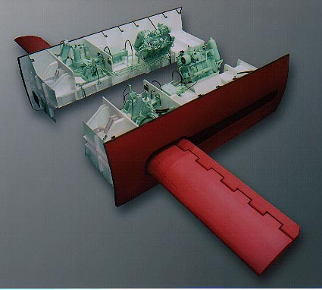
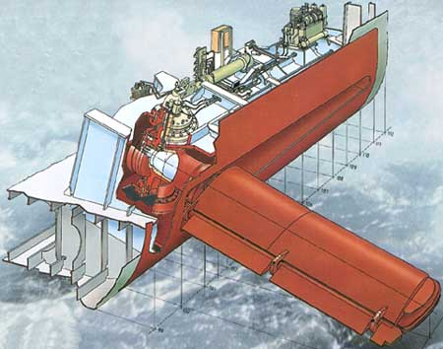
Ship Response Reduction
Fin Stabilizer

Slide 48
Ship Response Reduction
Ship Operation
Encountering frequency
Ship response can be reduced by altering the
- ship speed
- heading angle or
- both.

Slide 49
Example Problem
ship speed = 20 kts, heading angle=120 degree
wave direction : from north to south, wave period=12 seconds
Encountering frequency ?
Wave frequency :
N
Encountering angle :
120°
Encountering freq. :
V=20kts
S

Slide 50
Example Problem
You are OOD on a DD963 on independent steaming in the center of your box during supper. You are doing 10kts on course 330ºT and the waves are from 060ºT with a period of 9.5 sec. The Captain calls up and orders you to reduce the Ship’s motion during the meal. Your JOOD proposes a change to course 060ºT at 12 kts. Do you agree and why/why not? The natural frequencies for the ship follow:
ω_{roll} = 0.66 rad/s ω_{longbend} = 0.74 rad/s
ω_{pitch} = 0.93 rad/s ω_{torsion} = 1.13 rad/s
ω_{heave}= 0.97 rad/s

Slide 51
Example Answer
Your current condition:
ω_{w} = 2π/T = 2π/9.5 sec = .66 rad/s
Waves are traveling 060ºT + 180º = 240ºT
ω_{e} = ω_{w} - (ω_{w}²Vcosµ) / g
= .66 rad/s – ((.66rad/s)² × (10 kt × 1.688 ft/s-kt) × cos(330º - 240º)) / (32.17 ft/s²) = .66 rad/s = ω_{r}
Encounter frequency is at roll resonance with seas from the beam - bad choice

Slide 52
Example Answer
JOOD proposal:
ω_{e} = ω_{w} - (ω_{w}²Vcosµ) / g
= .66 rad/s – ((.66 rad/s)² × (12 kt × 1.688 ft/s-kt)
× cos(060º - 240º)) / (32.17 ft/s²) = .93 rad/s = ω_{p}
Encounter frequency is at pitch resonance with seas from the bow - another bad choice.
Try 060º at 7kts:
ω_{e} = ω_{w} - (ω_{w}²Vcosµ) / g
= .66 rad/s – ((.66r ad/s)² × (7kt × 1.688 ft/s-kt)
× cos(060º-240º)) / (32.17ft/s²) = .82 rad/s
This avoids the resonant frequencies for the ship - Good Choice.

